Slide 1
Celebrating the value and impact of AHP Research and Innovation! Resources Round-Up
News
Resources
Networks
Events
Publications

Slide 2
Deadline = 30th January 2023

Slide 3
https://cahpr.csp.org.uk/content/cahpr-top-ten-tips

Slide 4
https://www.youtube.com/watch?v=nuHz5Z5MYxQvBo

Slide 5
https://cahpr.csp.org.uk/content/cahpr-research-practitioners-framework

Slide 6
https://www.councilofdeans.org.uk

Slide 7
https://www.collegeofradiographers.ac.uk/research-grants-and-funding/research/formal-radiography-research-mentoring-(forrm)

Slide 9
https://www.rcot.co.uk/
Closing date 15th February 2023

Slide 10
https://library.nhs.uk/knowledgehub/

Slide 11
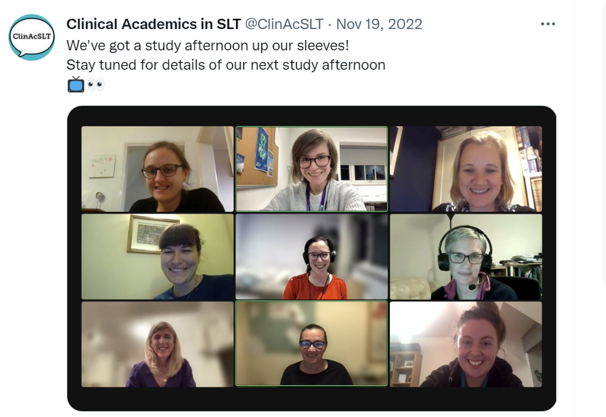
https://twitter.com/ClinAcSLT

Slide 12
https://www.vitae.ac.uk/doing-research/toolkits-to-enable-managers-to-support-the-development-and-progression-of-early-career-researchers

Slide 13
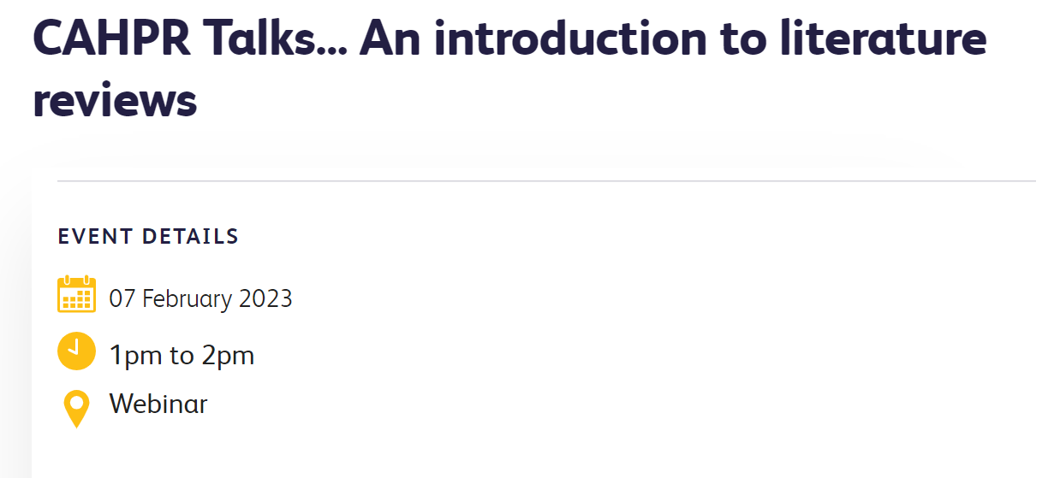
https://cahpr.csp.org.uk/

Slide 14
https://naep-uk.org/

Slide 15
https://www.vitae.ac.uk/doing-research/toolkits-developing-sustaining-researcher-networks

Slide 16
https://www.youtube.com/watch?v=FYMIH_scvBo

Slide 17
https://publications.coventry.ac.uk/index.php/pblh/index
Forum for dialogue around research into practice-based learning.
International editorial team
Hosted on the Open Journal System (OJS)
Free to read and to publish
Double-blind peer review

Slide 18
Abstract deadline 11/06/2023
https://ncor.org.uk/conference-2023/

Slide 19
https://www.facebook.com/groups/351873385356662/

Slide 21
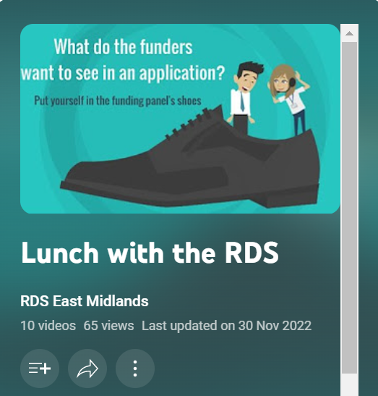
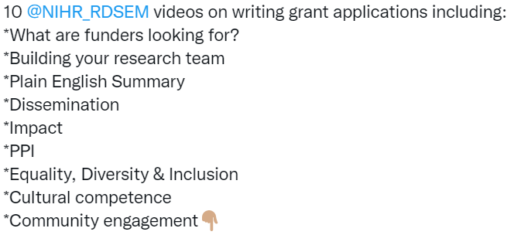
https://www.youtube.com/playlist?list=PLv3KY0eYPg1tMmjZ8W_C3ZnB7cRw-CALx

Slide 22
https://www.councilofdeans.org.uk

Slide 23
https://web.cvent.com/event/15656632-6c7d-4fc0-a732-29eb63d80a64/summary

Slide 24
https://www.sheffield.ac.uk/scharr/postgraduate/courses/nihr-mclin-res

Slide 25
https://www.youtube.com/watch?v=FYMIH_scvBo

Slide 26
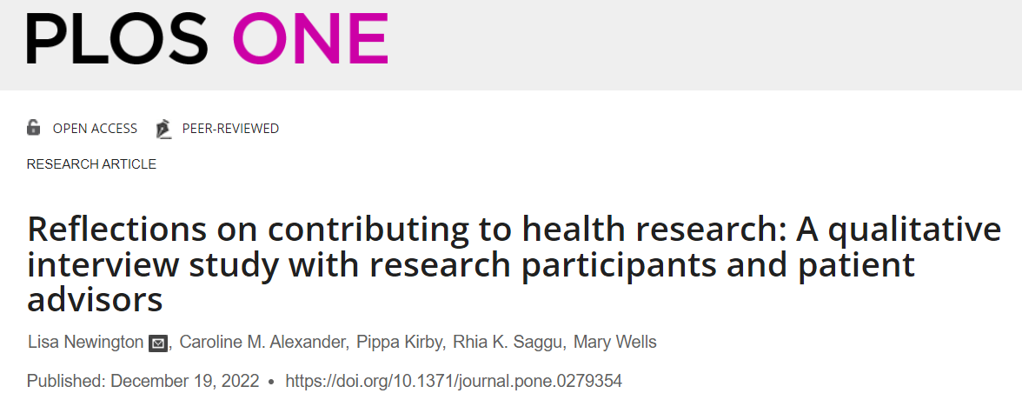
https://journals.plos.org/plosone/article?id=10.1371/journal.pone.0279354

Slide 27
https://www.youtube.com/watch?v=byBsYaeRN0A

Slide 28
https://onlinelibrary.wiley.com/doi/10.1111/1460-6984.12812

Slide 29
https://blogs.lse.ac.uk/

